Slide 1
Welcome -DRK MBA Family…….

Slide 2
INDUSTRIAL VISIT REPORT
DATE- 24/06/2022
TIME- 11.00 AM TO 0.1.00AM
NAME- GADRE MARINE EXPORT PVT.LTD
VENUE- MIDC , MIRJOLE BLOCK, RATNAGIRI

Slide 3
LOCATION
………………………………………….

Slide 4
Details of journey…..
Department of MBA organized 01 day industrial visit on Friday,24 June 2022. The visit was arranged for MBA 1ST year student’s only. Total 38 students have taken part in the industrial visit. The visit was at Gadre marine export pvt,ltd.

Slide 5
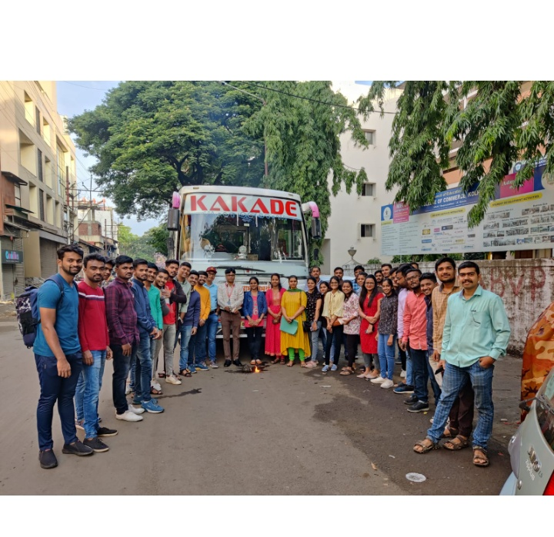

Slide 6
Company profile
About Gadre marine export pvt.ltd :-company was established in 1978. Gadre marine has factories at 4 location spread across Maharashtra, karnataka and Gujarat. This is leading marine product exporting company in india.
Facilities at :-
Surimi plant
Crab stick and value added products plant
Fish oil processing plant
Cold storage facilities
Packaged frozen fish plant

Slide 7
Company structure
Branches:-
Gadre marine export
Gadre marine export pvt,ltd
Damodar shivram & com.
ADG shrimp farm
Gadre Agrotech
Gadre infotech
Gadre powerplant
SVM be more (school)

Slide 8
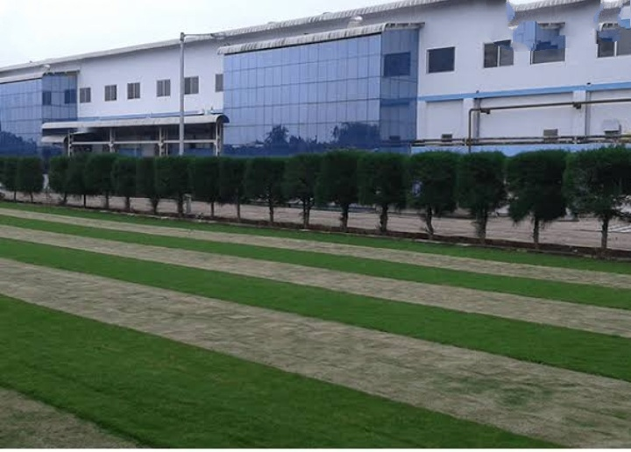

Slide 9
History of company
1400 cr yearly turnover.
Export than 35 countries.
Asia biggest surimi producer.
300 mt / day surimi production.
75 mt / day Surimi value added production.
3000-3500 employees.
State of Art technology.

Slide 10
Value and vision
Values :-
Foundation of our culture.
Trust and honesty .
Excellence and innovation.
Quality and integrity.
Care and giving back to community.
Vision :-
To become a leading brand in the surimi analogue product business in the world, through a world – class infrastructure , international quality standards and stringent safety practice.

Slide 11
…………………………..
Leader – MR Deepak Gadre ( chairman )

Slide 12
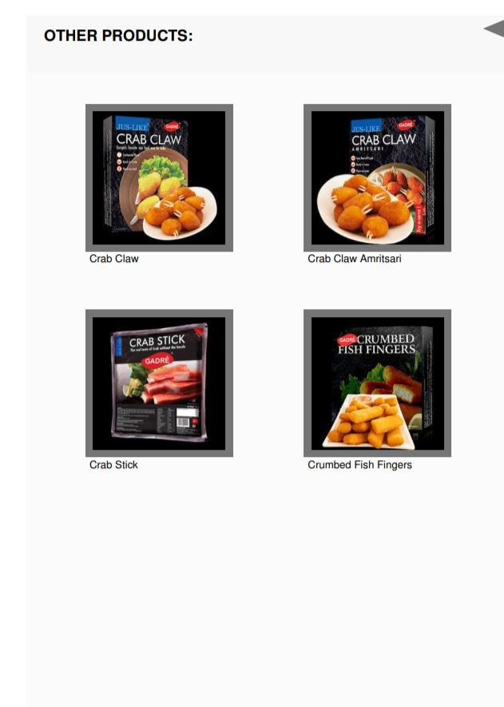
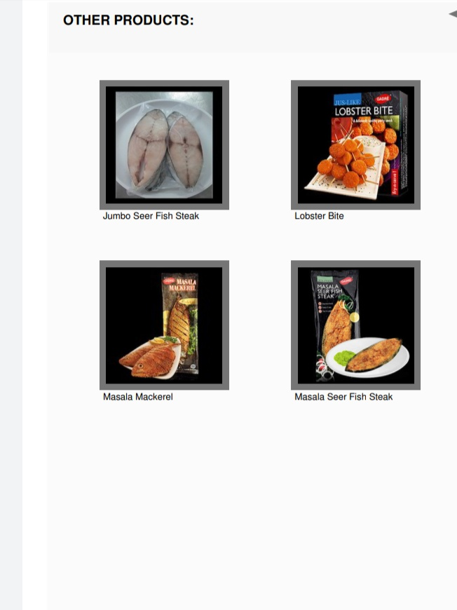
Products
……………………………………

Slide 13
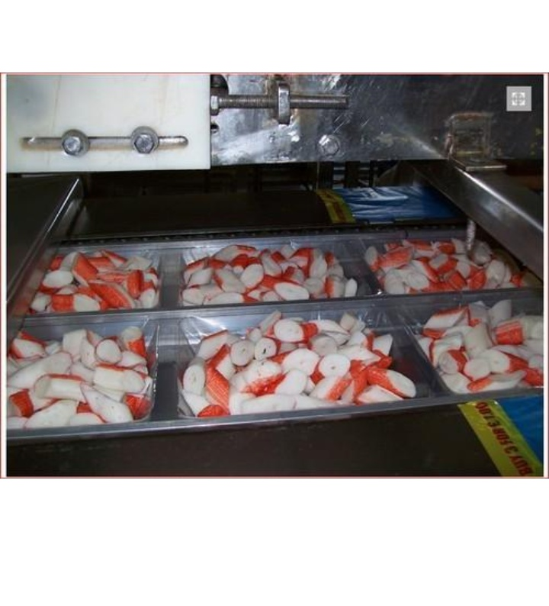
Production window
………………………………………………………………………………

Slide 14
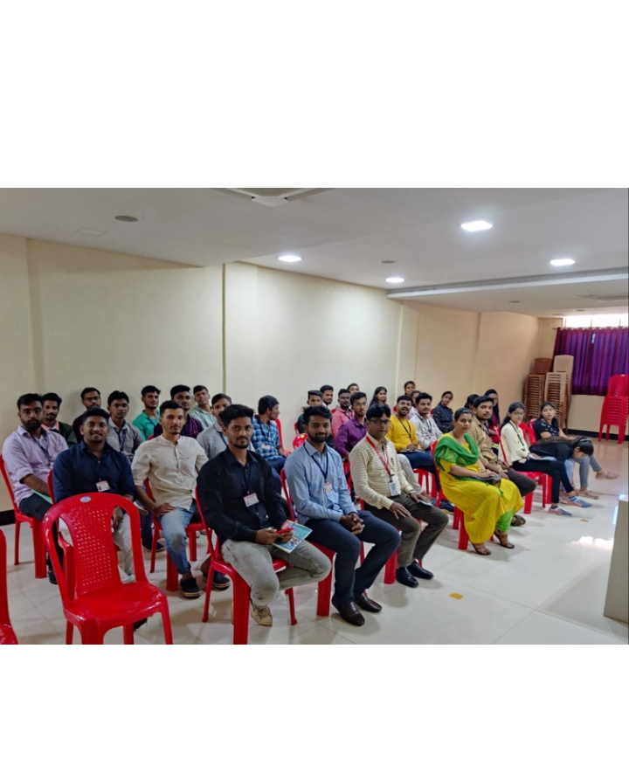
Presentation time
……………………………………………………………………………

Slide 15
Personal experience
Industrial visits provide the students with an opportunity to learn practically through interaction , working methods and empolyment practices. It gives the students an exposure to current work practices as opposed to theoretical knowledge being taught at their college classrooms.

Slide 16
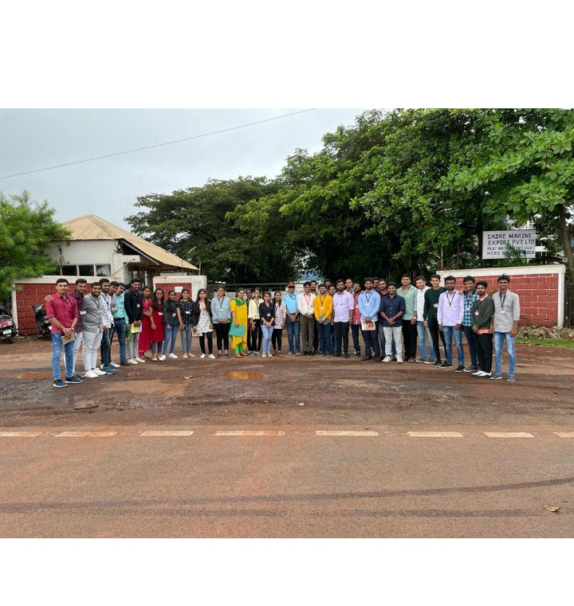

Slide 17
OUR DRK MBA FAMILY
…………………………………………………………………………

Slide 18
Thank you
Done by :-
Sakshi hardikar
Vaishnvi katware
Tanmay hawal
Satish sounule.

